Slide 1

BLOCK CODING LEARNER
Session 50
Build Personal Chatbot Assistant

Slide 2

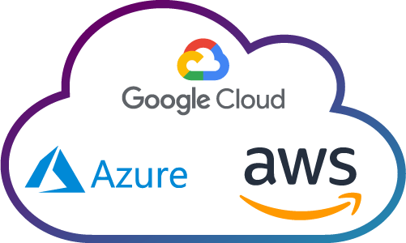
Recall…
What we have learnt in last session
What challenges you are facing

Slide 3
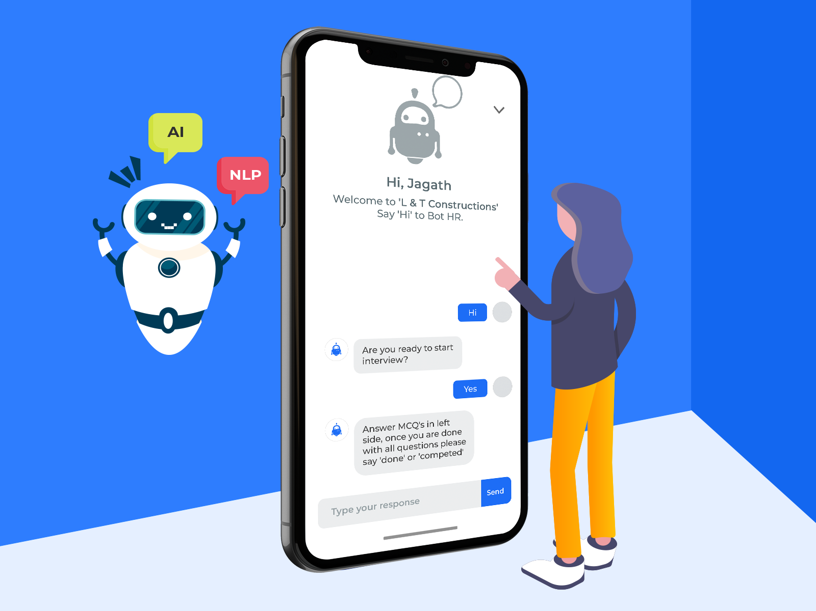
Build Personal Chatbot Assistant…
We will Learn today:
What are Chat bots?
How Chat bots work?

Slide 4
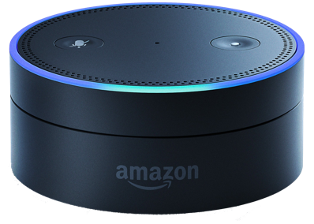
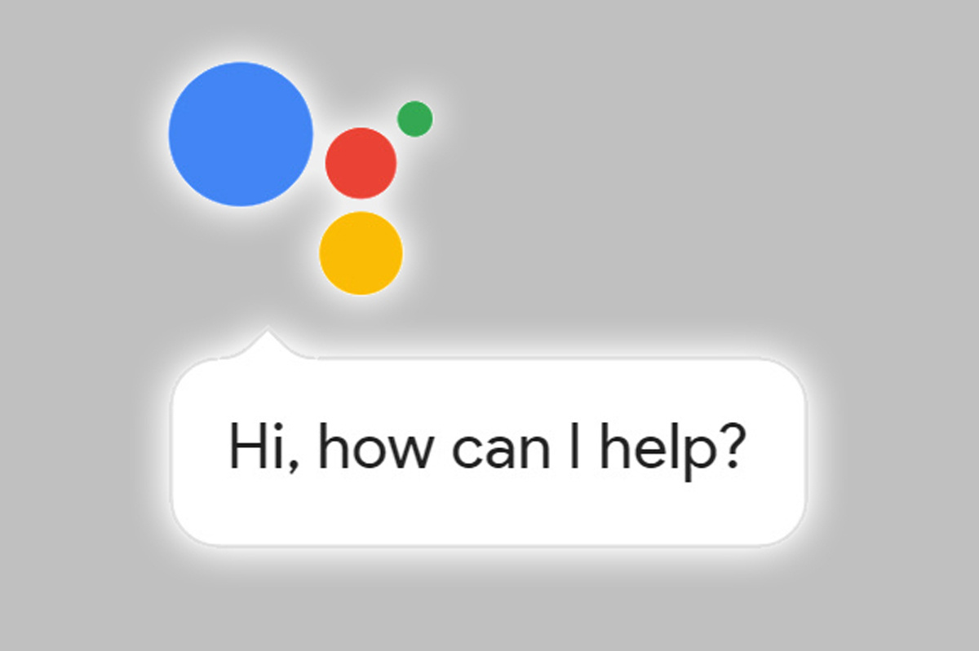
Personal Chatbot Assistant…
Chatbots are essentially a form of automated service that customers can communicate with via text or voice on different channels such as - Website, Facebook Messenger, Phone, or via voice assistants such as - Amazon Alexa, Google Assistant

Slide 5
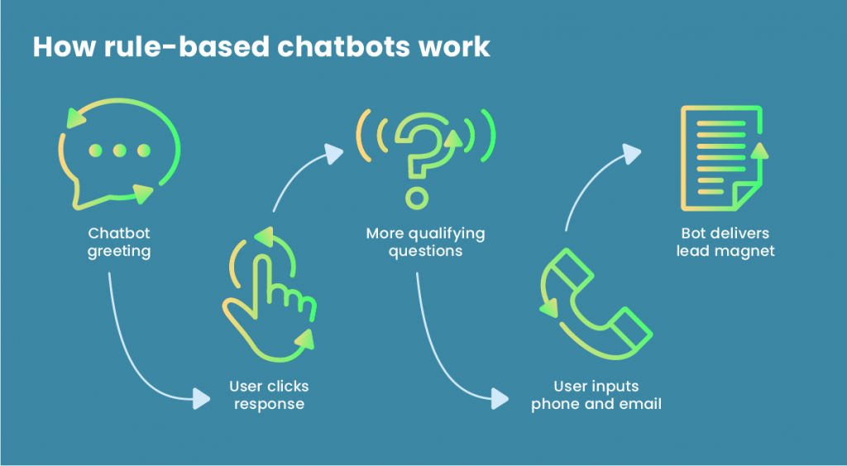
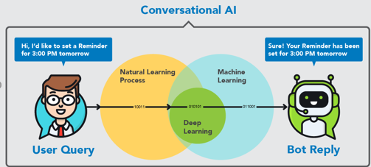
Types of chatbots…
There are two types of chatbots :
Rule-based – Here, possible user queries and potential answers are defined in advance
AI-based – Here, chatbots based on Artificial Intelligence are able to process Natural Language

Slide 6
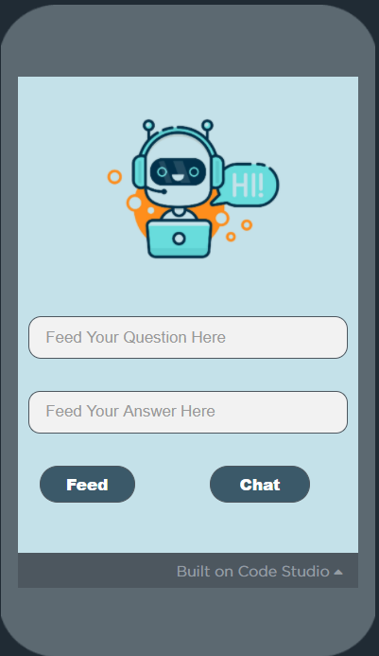
Demonstration…
Personal Chatbot Assistant App

Slide 7
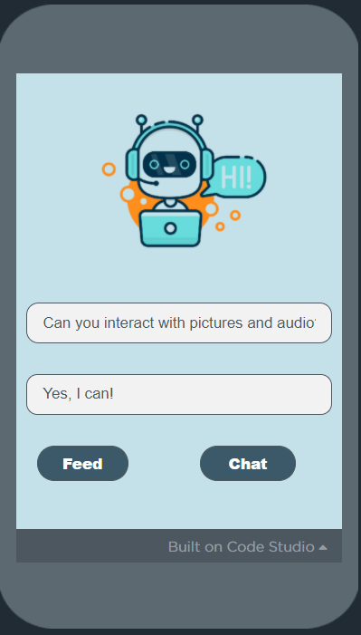
Demonstration…
User Interface to feed Your questions and Answers into the database screen

Slide 8
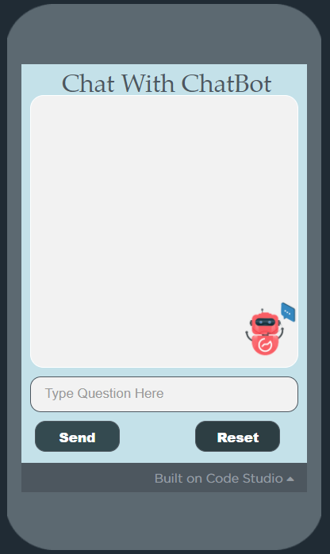
Demonstration…
User Interface of Chat Screen

Slide 9
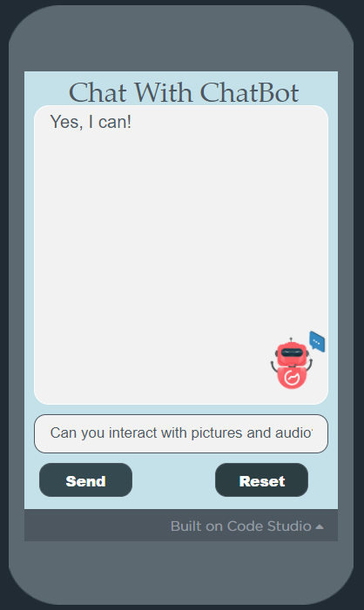
Demonstration…
To Chat with your personal Chatbot

Slide 10
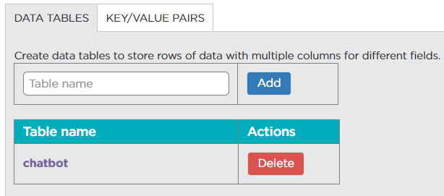
Data Viewer…
“chatbot” data storage in App lab

Slide 11
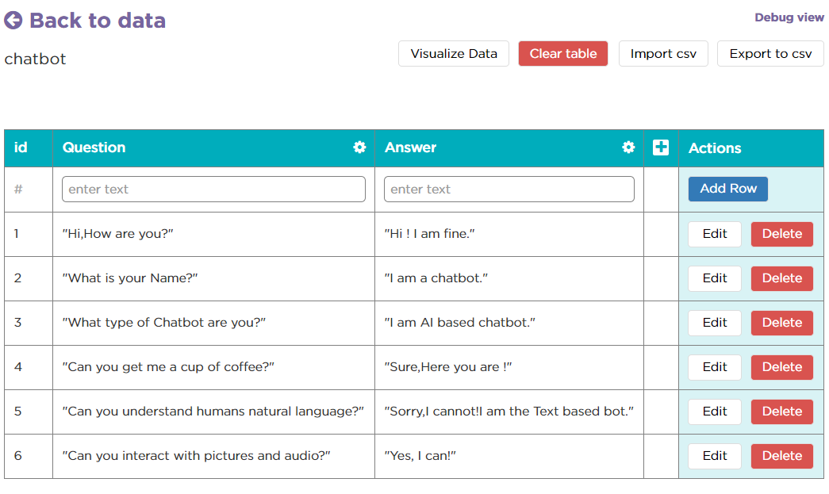
Data Viewer…
Questions and Answers fields created

Slide 12
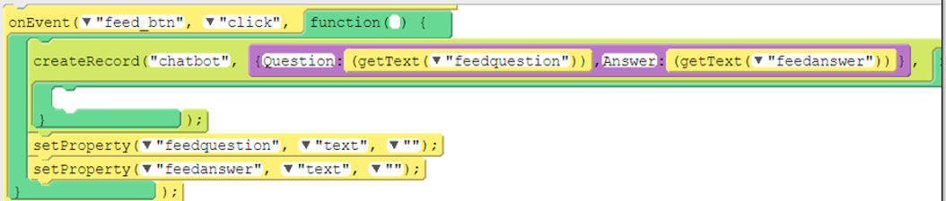
Code View of Chatbot Assistant App…
Code snippet for “Feed” button

Slide 13
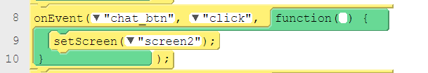
Code View of Chatbot Assistant App…
Code snippet for “Chat” button

Slide 14
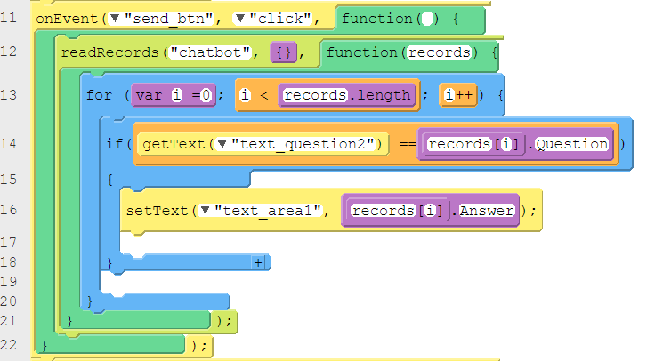
Code View of Chatbot Assistant App…
Code snippet for “Send” button

Slide 15
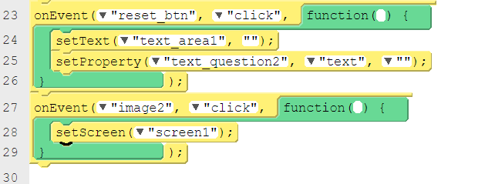
Code View of Chatbot Assistant App…
Code snippet for “Reset” button & Image click

Slide 16
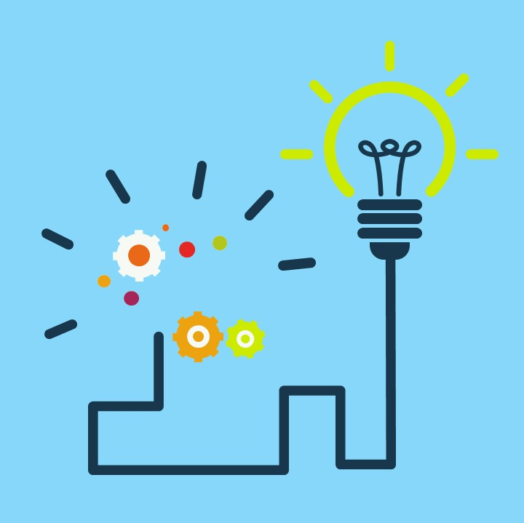
Summary…
What are Chat bots?
How Chat bots work?

Slide 17
Next Session…
Introduction to Cyber Security:
What are Chat bots?
How Chat bots work?

